Slide 1
Charan Tej K
Chavali Surya Teja
Sandeep Preetham M C
Rohith T
AIE19013
AIE19014
AIE19058
AIE19064
SMART FAN SYSTEM USING DHT SENSOR
19AIE114 - Principles of Measurements and Sensors

Slide 2
CONTENTS
INTRODUCTION
NECESSITY OF SMART FANS
DESCRIPTION
COMPONENTS USED
CIRCUIT AND CODE ANALYSIS
ADVANTAGES
DISADVANTAGES
CONCLUSION

Slide 3
INTRODUCTION
Smart fan system works in such a way that it automatically starts and stops to work based on the amount of temperature and humidity present in the room.
Ordinary fans are commonly used in places where the temperature is normal . But now the concept of smart homes is getting popular all over the world.
So, the demand for the smart fan systems has become very high nowadays.

Slide 4
WHY IS IT NEEDED?
The only viable solution for cheaper cooling appliance is a smart fan other than any type of air conditioner.
Smart ceiling fans are necessary because they can act based on the home’s ambient temperature by sensing the current temperature and humidity of the surroundings
Elevated air movement can be used to make heat exchange process faster as the air near body becomes warm and humid it is quickly replaced by drier and cooler air , which won’t work properly in case of window air conditioners .
Thus , these smart fans keep a person comfortable considering this process.

Slide 5
DESCRIPTION
Our project mainly targets on developing an automated “Smart Fan” to modern concept of smart homes by minimizing human interactions and making the ordinary fan more user-friendly.
This is a simulation based project and the simulation has been done using Arduino(UNO) on the platform(software) Proteus.

Slide 6
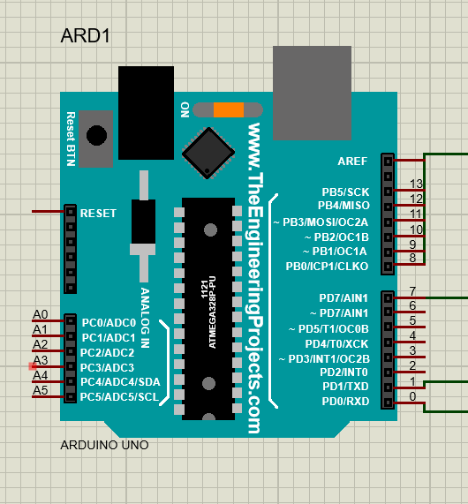
COMPONENTS
ARDUINO UNO :
To allow any home appliance to be intelligent it needs a controller as it’s brain needed in the system and Arduino UNO is by far the best choice for the development since it bears a reasonable price.
The Arduino UNO is a open-source microcontroller board based on the microchip ATmega 328P.
The board is equipped with sets of digital and analog input/output pins that may be interfaced to various expansion boards and other circuits.

Slide 7
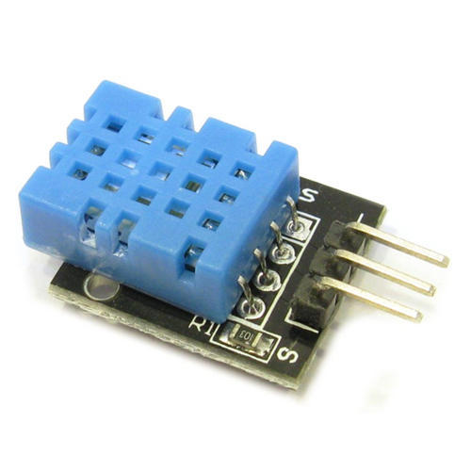
DHT SENSOR :
The DHT is low cost digital sensor for sensing temperature and humidity.
This sensor can be easily interfaced with any microcontroller like Arduino ,Raspberry Pi etc….
Since the DHT sensor produces a digital output and price is very reasonable ,this is very much suitable for temperature and humidity detection.

Slide 8
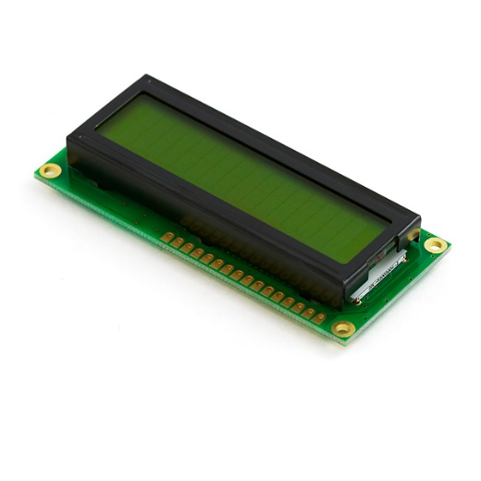
LCD :
A liquid crystal display is a flat panelled display used in monitors ,which uses liquid crystals in its primary form of operation
For this project we have used LCD LM016L which contains 14 pins .
As the name suggests it contains 16 columns and 2 rows, so it will have (16 x 2=32) 32 characters in total . Each Character will be made of pixel dots
This can be easily interfaced with Arduino UNO board by at least connecting 6 of its pins.

Slide 9
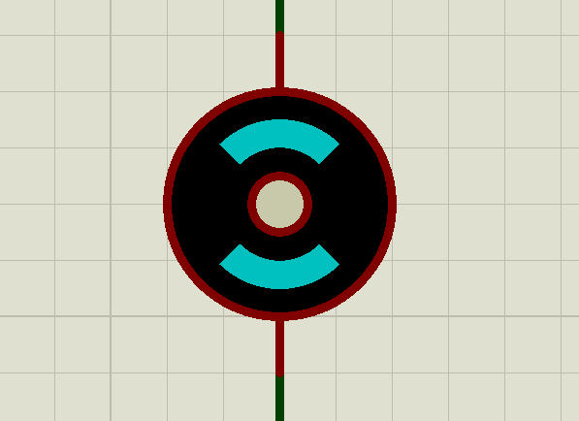
DC MOTOR :
When we look at the hardware side a DC motor is a machine that transforms electrical energy to mechanical energy in the form of rotation.
Considering our simulation we used the simple DC motor as a model representing a fan.

Slide 10
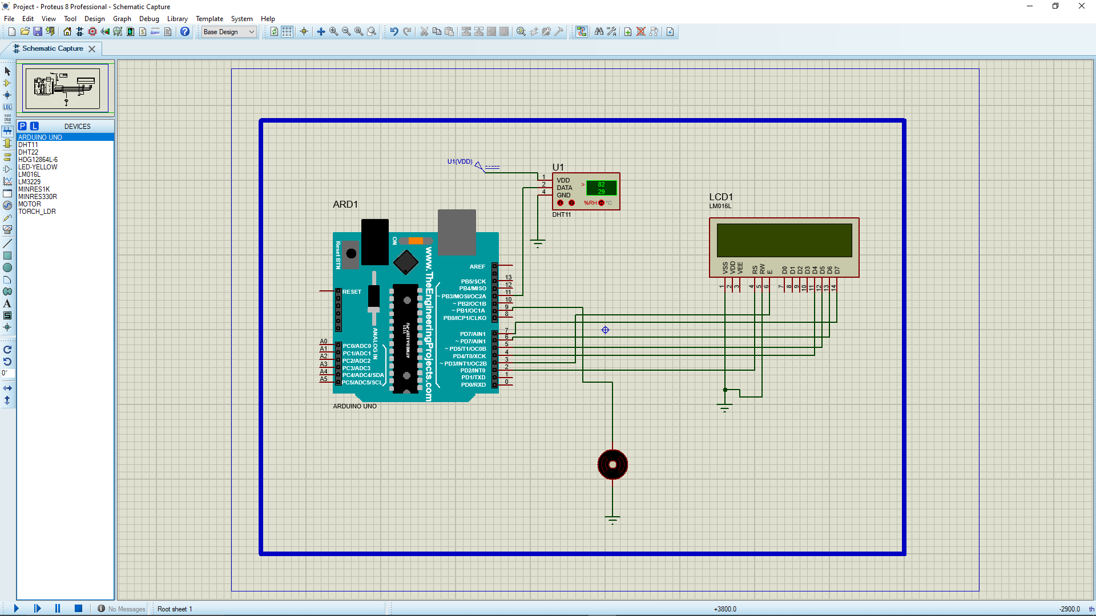
SIMULATION

Slide 11
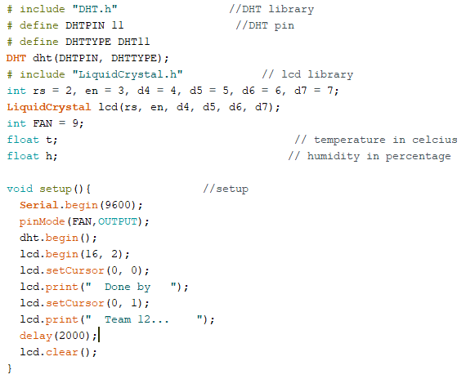
CODE ANALYSIS

Slide 12
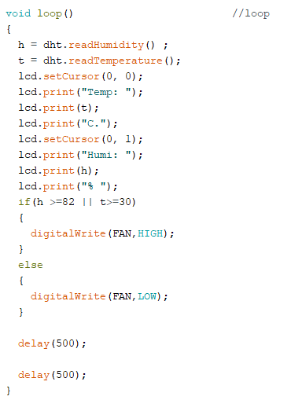
CONTD…

Slide 13
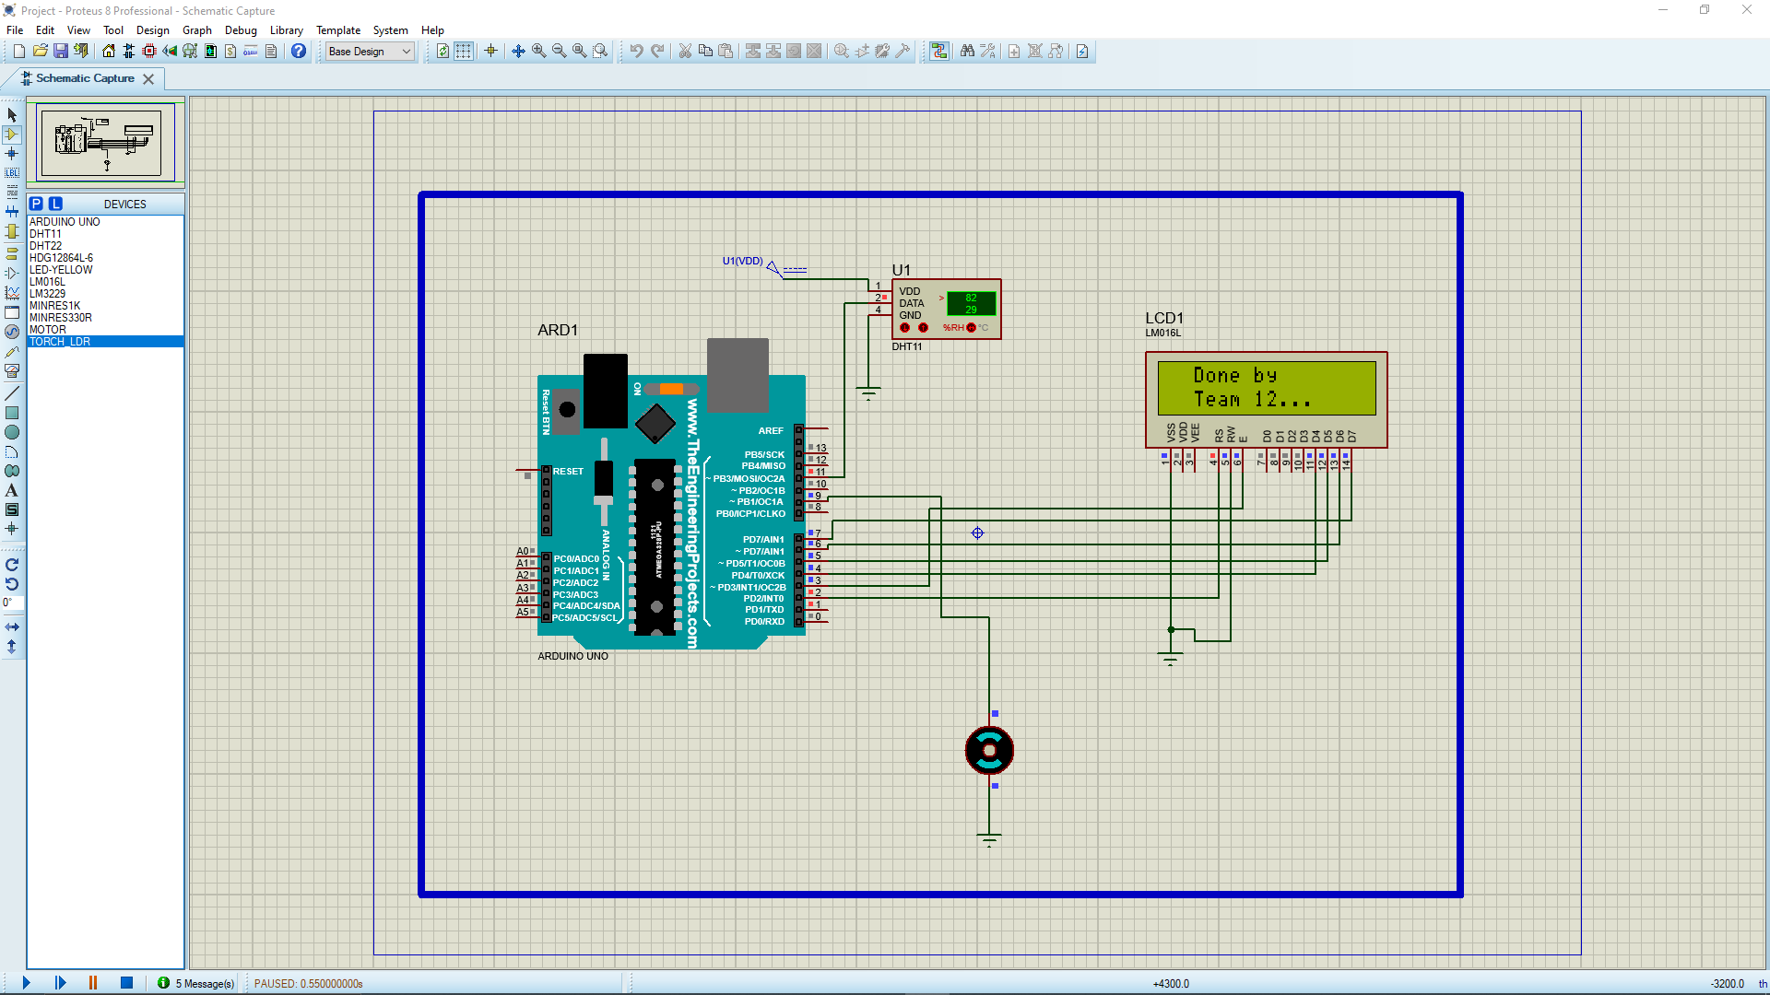
OUTPUT

Slide 14

OUTPUT

Slide 15

OUTPUT

Slide 16
ADVANTAGES
The main advantage of the smart fan systems is that they provide a hassle-free experience. We no longer need to disrupt our workflow to turn the fan on/off.
In case of an automated fan control with speed control , we get an optimized fan performance. The automation software calculates all of this for us and perfectly optimizes the fans’ performance for the current climate.
Smart fans can be part of an energy saving solution for your home. Using integration with temperature sensors instead of leaving your fans running all day long while you are away from home you can have them only turn on when your rooms temperature rises above a certain amount.

Slide 17
DISADVANTAGES
The main disadvantage of smart fan systems is that they are much more expensive than normal ceiling fans.
They require additional steps for installation and also demand increased complexity and maintenance.

Slide 18
CONCLUSION
In this project, the necessary steps, methods, hardware and software is presented to create an automated smart fan. The simulated model , when converted to a prototype is an deal fan for many people.
Although this system does not have a database because it is just a home appliance. However, it can be put together for future work to collect data usage and analysis for any purposes such as users’ behavior, energy consumption prediction and historical data usage in specific periods of time for energy consumption reduction.
Lastly, what is learned is that any systems should be built based on the consumers’ needs, preferences, and favorites in order to make the best out of it.

Slide 19
REFERENCES
https://www.researchgate.net/publication/323713954_Automatic_Speed_Control_and_Turning_ONOFF_for_Smart_Fan_by_Temperature_and_Ultrasonic_Sensor
https://iopscience.iop.org/article/10.1088/1757-899X/325/1/012022/pdf
https://www.researchgate.net/publication/330511595_Smarty_Smart_Fan

